Slide 1
Rules of Evidence and Objections
Mock Trial Rules

Slide 2
Why have evidence rules?
Ensure a fair hearing
Avoid wasting time/resources
Keep out unreliable or prejudicial evidence

Slide 3
Leading Questions
Question suggests the answer that the attorney wants
NOT allowed during direct examination
Objectionable: “Is it true that you locked the door when you left the house?”
Better: “What did you do, if anything, when you left the house?”
Best: “What did you do next?”

Slide 4
Argumentative Questions
Do not badger, harass, or argue with the witness
→For a difficult or hostile witness, rephrase your question or use the impeachment process
Objectionable: “Don’t lie to me. You were stupid and drunk and ran that red light, didn’t you? Didn’t you? You ran it and didn’t even care.”

Slide 5
Speculation
Question requires the witness to guess
Objectionable: “Would the driver have had time to slow down if he saw the light turn red?”
Better: “Where was the driver when the light turned red?”

Slide 6
Narration
Witness gives more information than necessary
Q: “Where do you work?”
Objectionable: “I went to college to be an architect but I got a job as a business consultant after graduation because my father knew the owner. I didn’t like that very much, so I quit when I met Jessica, who is a real estate developer and good friend. We decided to go into business together, using my architectural background to build and manage apartment buildings. We call it Cool Living Designs because...

Slide 7
Relevance
Questions and answers must relate to a disputed issue
Relevant information adds to the understanding of the case
Objectionable: “What’s your favorite coffee shop in Seattle?”

Slide 8
Hearsay
Statements made outside the courtroom are generally NOT allowed
Objectionable: “The bartender told me that the driver had been drinking all night.”

Slide 9
Hearsay Exceptions
Statement made about event when it happened that demonstrates the speaker’s intent, knowledge, or belief
Admissible: “After he got out of the car, the driver said ‘I’m sorry, I didn’t see the light turn red.’”
Statement made by a party in the case if it goes against his or her side
Admissible: “The next day, the driver told me she had been texting her boyfriend, so she didn’t see the light.”

Slide 10
First-hand Knowledge
Witness must have directly seen, heard, or experienced something to testify about it
Objectionable: “Everyone has been talking about how the driver ran the red light and caused that accident.”
Better: “I saw the light turn red while I was in the intersection, and the driver was about 100 feet behind me. A few seconds later I heard a huge crash.”

Slide 11
Opinions
Usually reserved for qualified expert witnesses regarding scientific, technical, or specialized subjects
Rationally based on the witness’s perception and observations
Objectionable: “The driver was definitely too drunk to drive.”
Better: “She seemed drunk to me because she was slurring her speech and couldn’t stand up straight.”
No opinions on how the case should be decided (Ultimate Issue)
Objectionable: “Do you think that the driver committed second-degree murder?”

Slide 12
Beyond the Scope of Cross Examination
Re-direct limited to topics discussed during cross examination
In a real trial, cross examination is limited by the topics discussed on direct

Slide 13
Beyond the Scope of the Packet
Significant or material facts that aren’t in the mock trial packet cannot be added to testimony
Minor details added to get into the role are fine

Slide 14
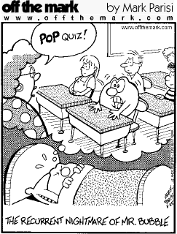
Rules of Evidence Review
Is there a violation?
If so, which objection would you make?

Slide 15
When to Object
Attorney questioning witness
Witness giving answer
Attorney admitting evidence

Slide 16
How to Object
Stand up
Address the judge
State the violation
Give a reason for the objection
Ex: “Objection, Your Honor, the witness is narrating. The attorney’s question has already been answered.”

Slide 17
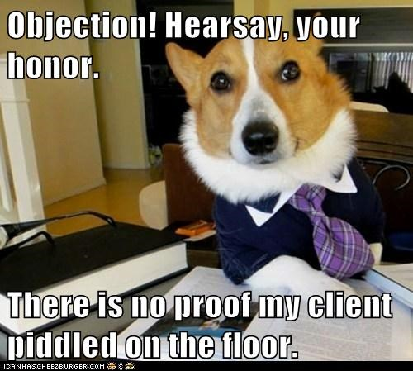
Practice Making Objections

Slide 18
Introducing Physical Evidence
Mark for identification
Show to opposing counsel
Build foundation with witness
Hand to witness
Ask witness if he/she recognizes it
Ask witness to explain/describe evidence
Ask questions about the evidence
Admit evidence as an exhibit

Slide 19
Impeaching a Witness
Discredit the witness
Show motives for lying
Show inconsistency in testimony
Clarify witness’s potentially false answer
Ask witness if he/she recognizes the statement
Ask witness to read the relevant section
Move on with your questions

Slide 20
Group Activity

